Slide 1


FAKE NEWS DETECTION
USING NLP
Group Members:
D.SANDHIYA
P.PRIYADHARSHINI
S.SRIABI
R.NAVEENA

Slide 2
Problem Overview

Slide 3
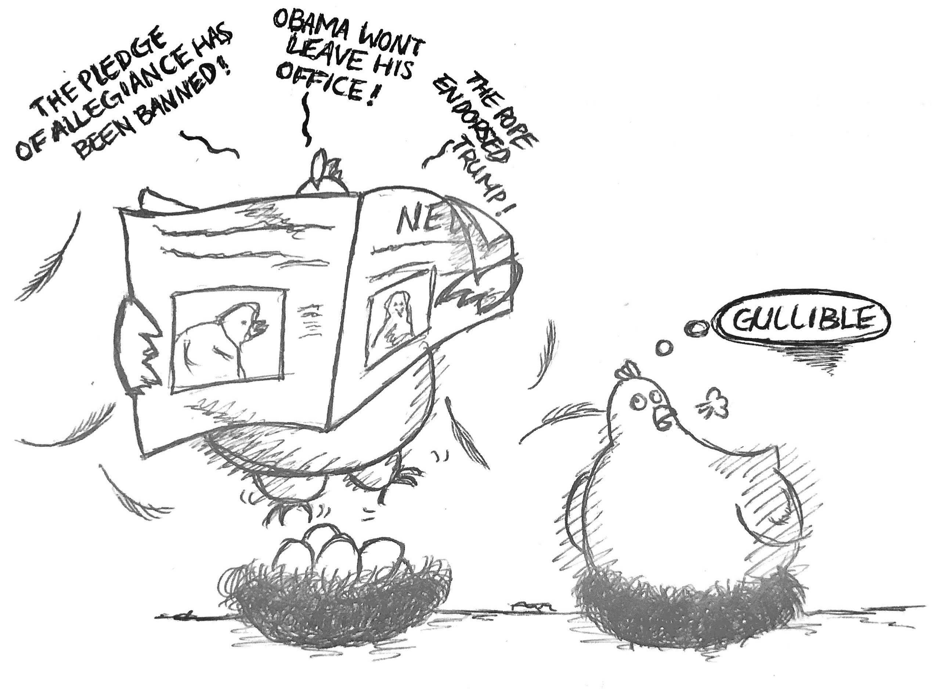
What is MISINFORMAION?
Misinformation: False or incorrect information
Purpose: Affect the perception of people
Notes:
Misinformation is false or incorrect information, it can be spread intentionally or unintentionally (without realizing it is untrue)

Slide 4

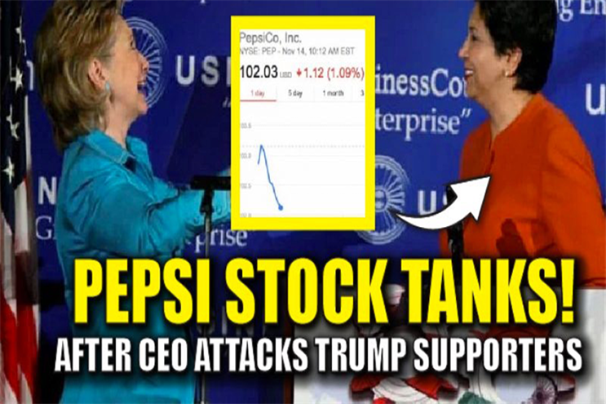
Sweden signed the deal to become a member of NATO??
Defend Misinformation!
PepsiCo CEO indra Nooyi told Trump fans to “take their business elsewhere”

Slide 5
Current Solutions
Linguistic approaches
Data Representation
Deep Syntax
Semantic Analysis
Rhetorical Structure and Discourse Analysis

Slide 6
Limitations of Current Solutions
Time Sensitivity
Quality vs Quickness
Operate in a retrospective manner
Results in the delay between the publication
and detection of a rumor
Latency aware rumor detection

Slide 7
Thank you!

